Slide 1

Healthy, Hunger-Free Kids Act of 2010
National School Lunch & School Breakfast Program
Meal Patterns
Offer vs. Serve
Meal or No Meal

Slide 2
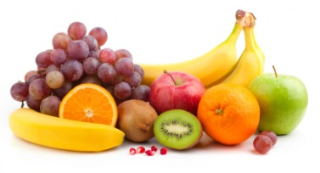
FRUITS
 | Breakfast |  |  | Lunch
Grades | K-5 | 6-8 | 9-12 | K-5 | 6-8 | 9-12
Meal Pattern | Amount of food per week (Minimum per day)
Fruits (cups) | 5 (1) | 5 (1) | 5 (1) | 2½ (½) | 2½(½) | 5 (1)
SY 2014-15
Fresh, canned in 100% fruit juice or light syrup, frozen, dried or 100% fruit juice
  No more than HALF of fruit offerings per WEEK may be juice
  ¼ cup dried fruit = ½ cup eq. of fruit offering

Slide 3
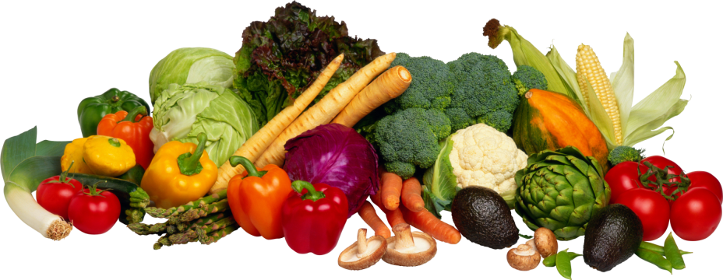
VEGETABLES
 | Lunch
Grades | K-5 | 6-8 | 9-12
Meal Pattern | Amount of food per week (Minimum per day)
Vegetables (cups) | 3 ¾ (¾) | 3 ¾ (¾) | 5 (1)
Dark green | ½ | ½ | ½
Red/Orange | ¾ | ¾ | 11/4
Beans/Peas (Legumes) | ½ | ½ | ½
Starchy | ½ | ½ | ½
Other | ½ | ½ | ½
Additional Veg. to Reach Total | 1 | 1 | 1 ½

Slide 4
VEGETABLE SUBGROUPS
Red/Orange | acorn squash, butternut squash, carrots, pumpkin, tomatoes, tomato juice & sweet potatoes
Beans/Peas (Legumes) | black beans, black-eyed peas (mature, dry), garbanzo beans (chickpeas), kidney beans, lentils, navy beans, pinto beans, refried beans, soy beans, split peas, vegetarian beans & white beans
Dark Green *NOTE: 1 CUP leafy greens = 1/2 cup vegetable serving | bok choy, broccoli, collard greens, dark green leafy lettuce, kale, mesclun, mustard greens, romaine lettuce, spinach, turnip greens* & watercress
Starchy | black-eyed peas (not dry), corn, cassava, green bananas, green peas, green lima beans, plantains, taro, water chestnuts, jicama, & white potatoes
Other | Other vegetables, such as artichoke, asparagus, avocado, bean sprouts, beets, Brussels sprouts, cabbage, cauliflower, celery, cucumbers, eggplant, green beans, green peppers, iceberg lettuce, mushrooms, okra, onions, parsnips, turnips, wax beans, & zucchini. Requirement may be met with any extra amounts from the Dark Green, Red/Orange or Beans/Peas (Legumes) Vegetable subgroups.
Add'l Veg to Reach Total | Any vegetable subgroup may be offered to meet the total weekly vegetable requirement.

Slide 5
VEGETABLES
Fresh, frozen, or canned vegetables and dry beans/peas (legumes)
1 cup leafy greens = ½ cup eq. veg offering
Beans/Peas (Legumes) may be credited as vegetable OR meat/meat alternates

Slide 6
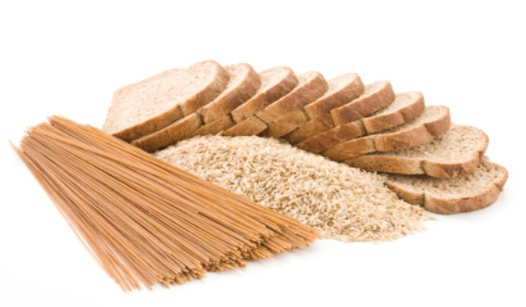
GRAINS
 | Lunch
Grades | K-5 | 6-8 | 9-12
Meal Pattern | Servings Per Week (Minimum per day)
Grains (oz-eq) | 8-9* (1) | 8-10* (1) | 10-12 *(2)
SY 2012-2013, at least HALF grains offered must be whole grain-rich (WGR)
SY 2014-2015, ALL grains offered must be WGR
WGR foods contain at least 50% whole grains
Two grain servings/week can be grain-based desserts
*Max. # of serving has been removed.

Slide 7
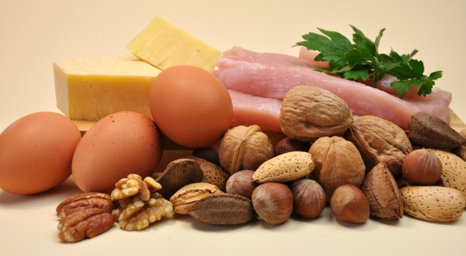
MEAT/MEAT ALTERNATES
 | Lunch
Grades | K-5 | 6-8 | 9-12
Meal Pattern | Amount of Food Per Week (Min. per day)
Meat/Meat Alternates (oz. eq) | 8-10* (1) | 9-10* (1) | 10-12* (2)
*Max. # of serving has been removed.

Slide 8
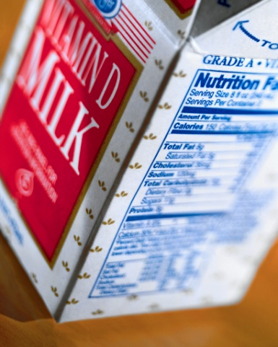
FLUID MILK
ALL age-grade groups must be offered 1 cup (8 fl.oz.) of milk per day
Allowable Milk Choices:
  Fat-Free unflavored or flavored milk
  Low Fat unflavored milk
  Fat-Free or Low Fat lactose-reduced or lactose-free milk
Must offer two choices
Milk requirements also apply to 3-4 year old children

Slide 9
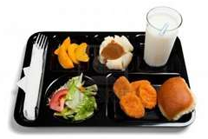
LUNCH OFFER VS. SERVE
Five meal components must be offered
  Fruits
  Vegetables
  Grains
  Meat/Meat Alternates
  Milk
Two of the five meal components can be declined by the student
*Student MUST take at least ½ cup of fruit or vegetable

Slide 10
LUNCH OFFER VS. SERVE
For Grades 9-12, if a student selects the following
  Fruit (1/2 C)
  Vegetable (1/2 C)
  And one other component (e.g. Milk)
then the student MUST take the FULL of fruit or vegetable serving (1 cup). The student need to take one of the following in addition
  Fruit (1/2 C)
  Vegetable (1/2 C)

Slide 11
BREAKFAST OFFER VS. SERVE
Three food components must be offered
  Grains
  Fruits
  Milk
Meat/ Meat Alternate (M/MA)
  Substitution for Grain (G)
  Substitute 1oz. eq. M/MA for 1 oz. eq. G after 1 oz. eq. G is offered.
Vegetable
  Substitution for Fruit
  First two cups per week must be from the Dark Green, Red/Orange, Bean/Peas/Legumes or Other Vegetables subgroups.
At least 4 food items must be offered
Student must take at least 3 food items

Slide 12
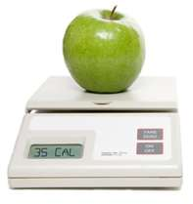
CALORIES, TRANS & SAT. FAT
 | Breakfast |  |  | Lunch
Grades | K-5 | 6-8 | 9-12 | K-5 | 6-8 | 9-12
Min-Max Calories | 350-500 | 400-550 | 450-600 | 550-650 | 600-700 | 750-850
ZERO grams of trans fat per serving
<10% of calories from saturated fat per week

Slide 13
I have completed the training for Breakfast and Lunch meal patterns, offer vs. serve, and Meal or No Meal.
School Name:
Training Sign off
Print Name | Signature | Date

Slide 14
I have completed the trainings for Breakfast and Lunch meal patterns, offer vs. serve and Meal or No Meal
School Name:
Training Sign off
Print Name | Signature | Date

